Slide 1
AWS CPU Forecasting

Slide 2
Information on data
First and last 5 observations
timestamp | value | aim
2014-02-14 14:30:00 | 0.132 | 24ae8d
2014-02-14 14:35:00 | 0.134 | 24ae8d
2014-02-14 14:40:00 | 0.134 | 24ae8d
2014-02-14 14:45:00 | 0.134 | 24ae8d
2014-02-14 14:50:00 | 0.134 | 24ae8d
... | ... | ...
2014-02-28 14:02:00 | 2.456 | fe7f93
2014-02-28 14:07:00 | 2.098 | fe7f93
2014-02-28 14:12:00 | 2.376 | fe7f93
2014-02-28 14:17:00 | 2.426 | fe7f93
2014-02-28 14:22:00 | 3.252 | fe7f93
No. of features: 3
No. of observations: 32256

Slide 3
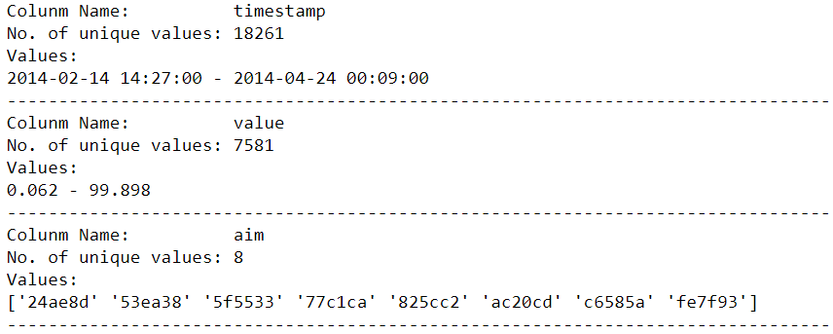
Information on data

Slide 4
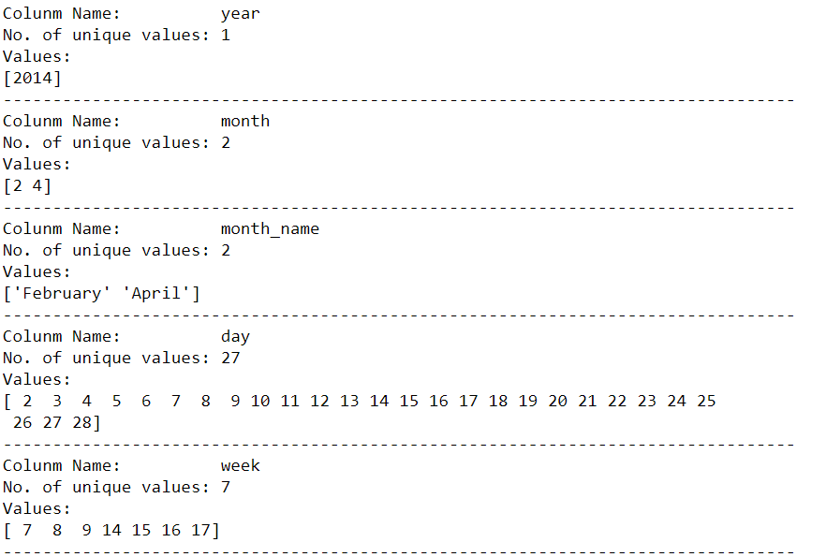
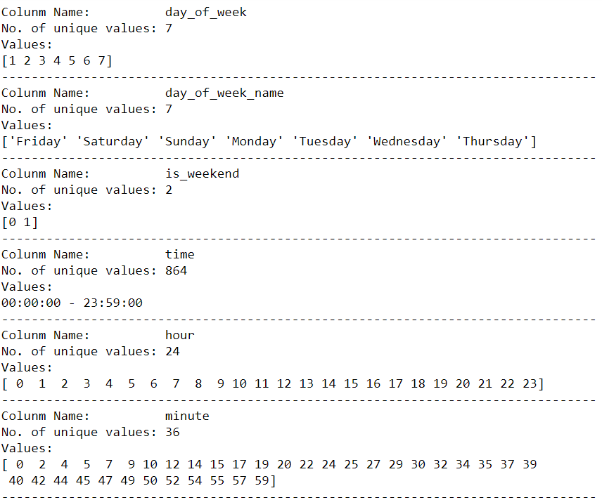
Adding date features

Slide 5
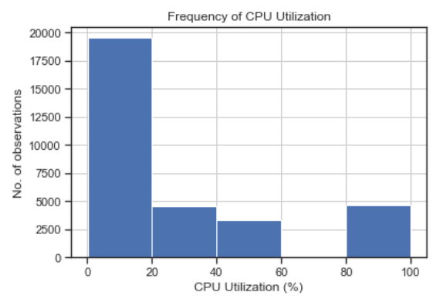
Frequency of CPU Utilization
CPU Utilization (%) seems to stay at 0 to 20 % for most of the observations

Slide 6
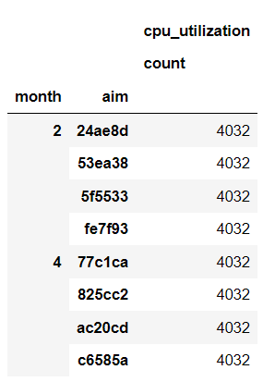
CPU Utilization
1. 4 AIM IDs were only used on February while other the 4 AIM IDs were used in April
2. All AIM IDs has the same number observations

Slide 7
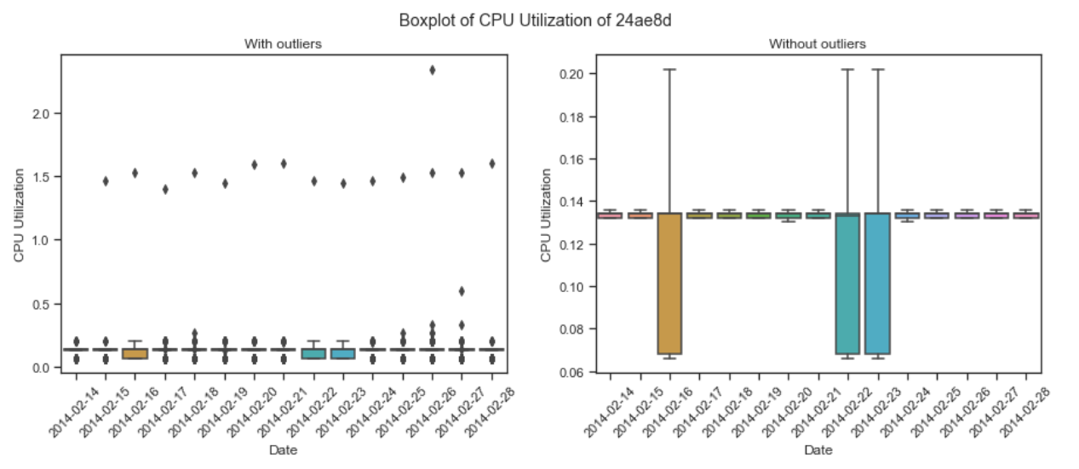
CPU Utilization: 24ae8d
Boxplot of 24ae8d
1. Outliers seems to have a trend on its own
2. Most dates same a pretty small spread of CPU Utilization percentage except for 16th, 22nd & 23rd
3. Such low percentage could mean CPU is in idle

Slide 8
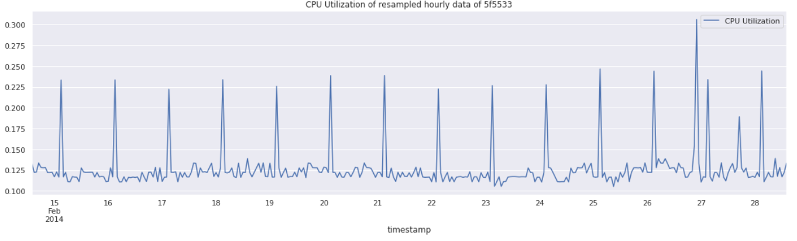
CPU Utilization: 24ae8d

Slide 9
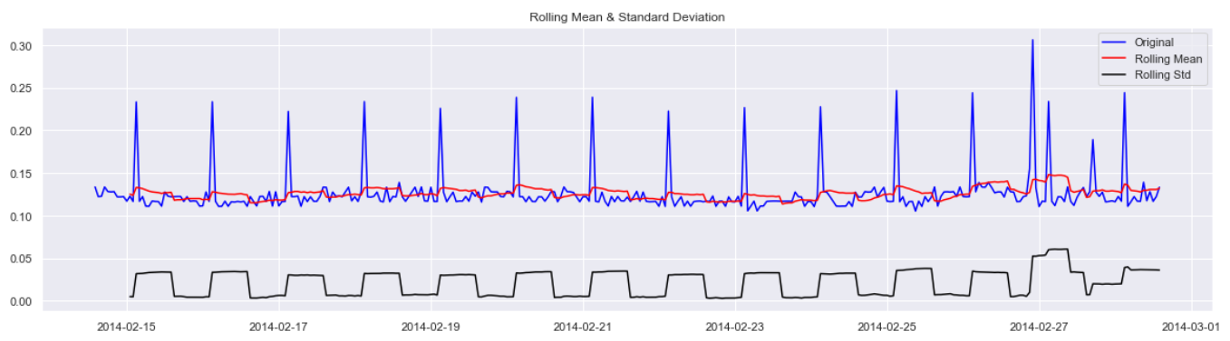
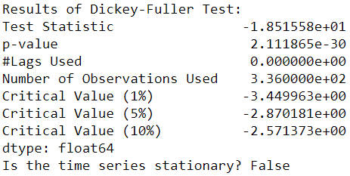
Stationary testing

Slide 10
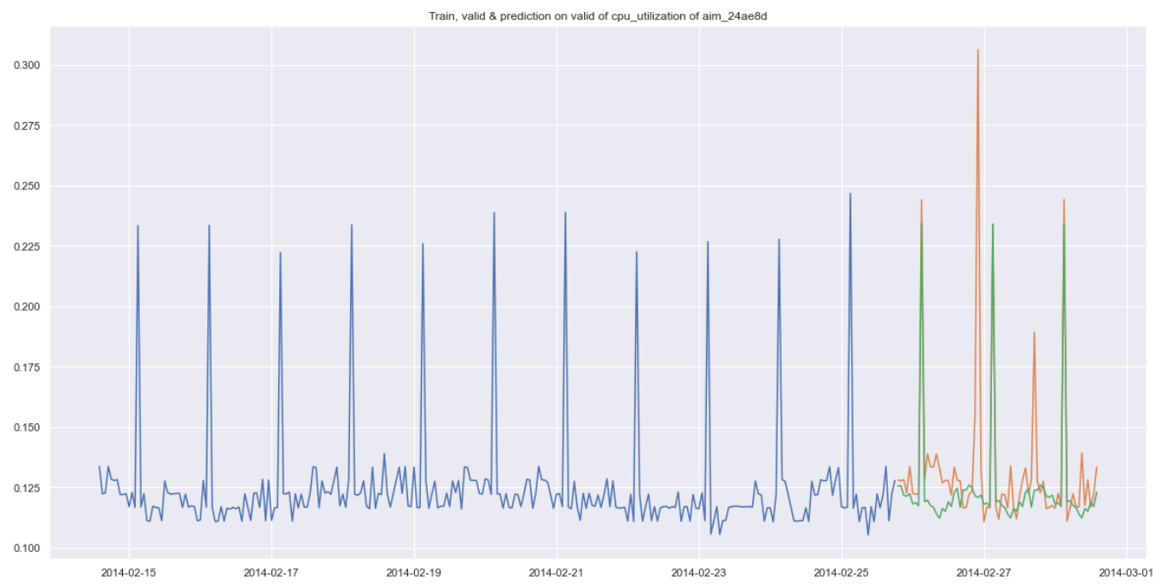
Train, valid & predict on valid on 24ae8d
Evaluation
RMSE | 0.025816

